Slide 1
Prototype #2 Meeting
Attendees:
Dr. Shaunn-inn Wu
Dr. Jared Macshane
Sushi Team

Slide 2
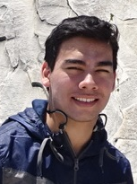
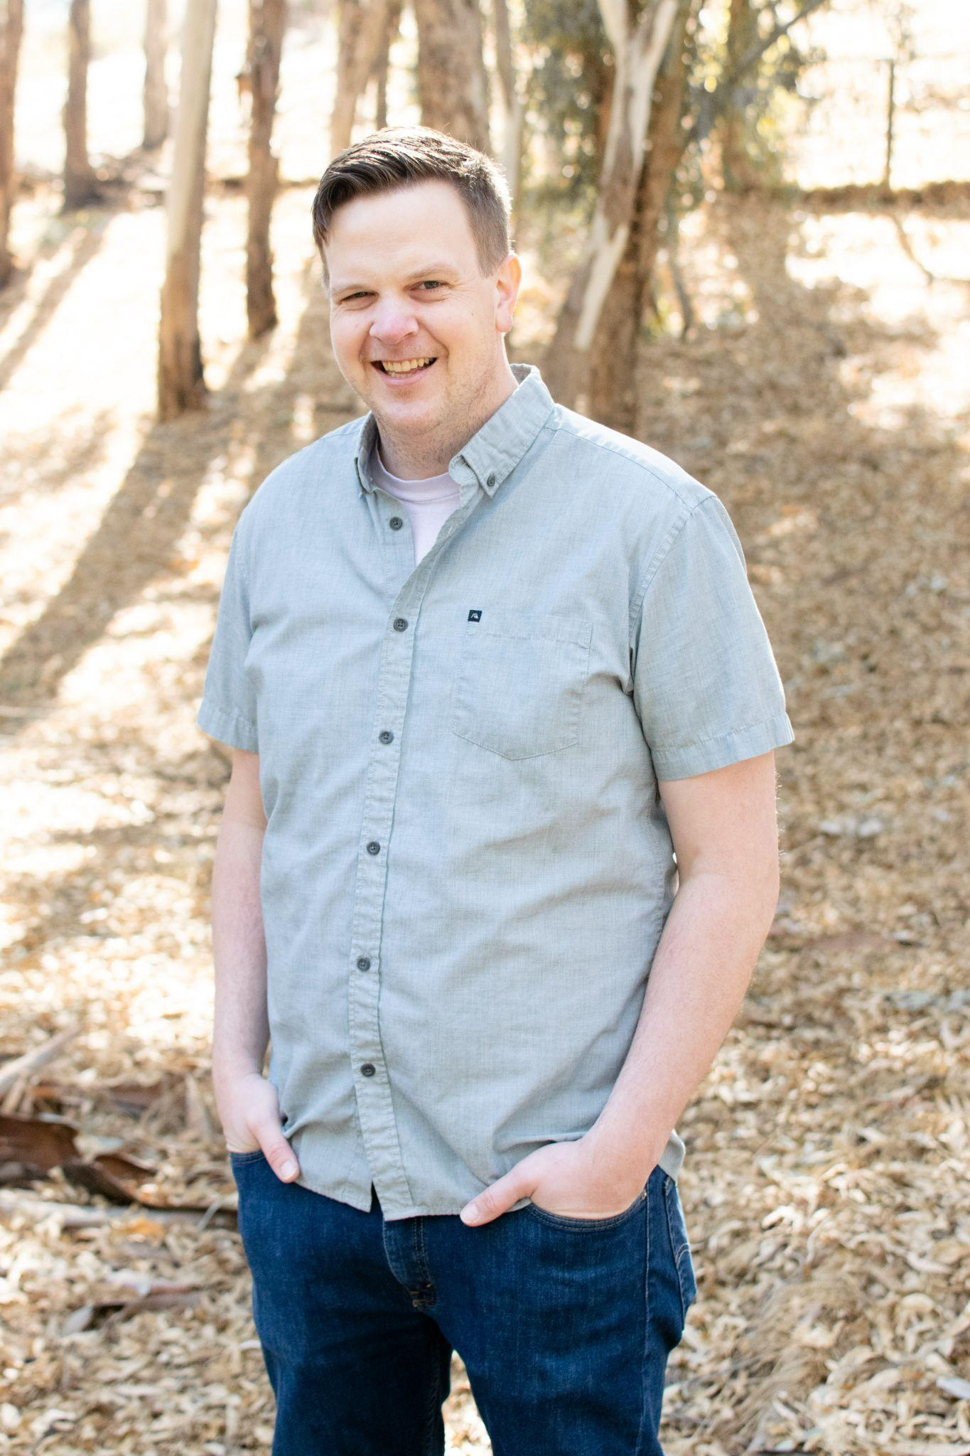
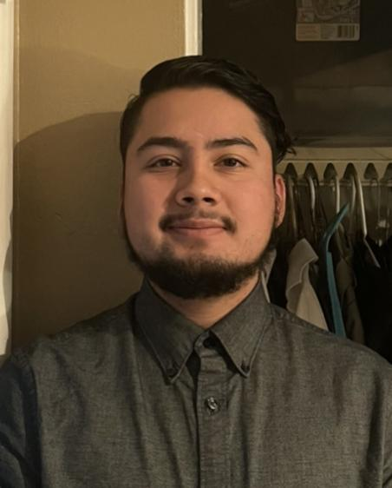
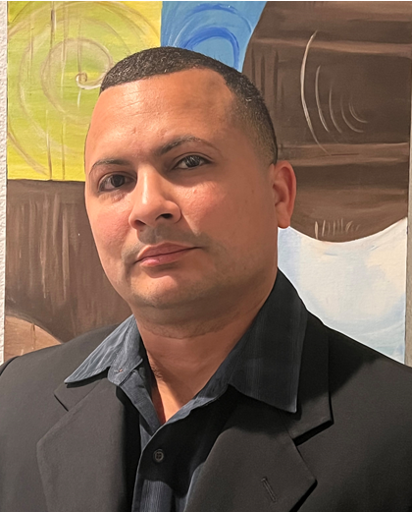
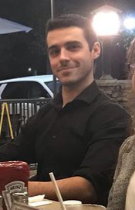
Formal Greetings
Team/Scrum Leader: Noah Miera
Programmer: Keith Gross
Project Manager: Juan Gonzalez
Programmer: Miguel Morales
Documentation/Training: Jordan Fisher

Slide 3
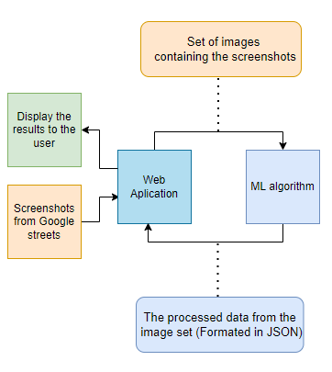
Current Requirements
As of the end of Prototype 1, we are operating with the following requirements:
Develop a system to receive and process Google Street images from a user (Web App Team).
Develop a Machine Learning algorithm that must be able to detect instances of litter in the received Google Street images.
Once the litter instances have been identified, the system must then process and output the results into a suitable format, such as JSON, for the user (Web App Team).
Once the results have been made, the system must then return the processed data to the user (Web App Team).
Train the final algorithm to categorize different kinds of litter (Contingent on the completion of other requirements)
Notes:
Go over requirements we’ve established through our JADs, and re-confirm them with Jared. (Take about 5 or more minutes, alongside the Network Diagram.)
Thank you, I just wanted to really quickly give a review of the requirements we are working with currently.
A method receive and process images from the user. In our case currently, we are working with the web app team as our user.
Our primary requirement is the development of machine learning algorithm to detect instances of litter that are present in the images received from the user.
Once the litter instances have been identified, the next step is to process the information into a format that is readable by the user.
Finally, we must develop a way to transfer the processed data to the user.
Additionally we are attempting to develop our final algorithm such that it can detect and categorize different types of litter such as paper, glass, etc. it should be noted that this requirement is contingent on the completion of the other requirements

Slide 4
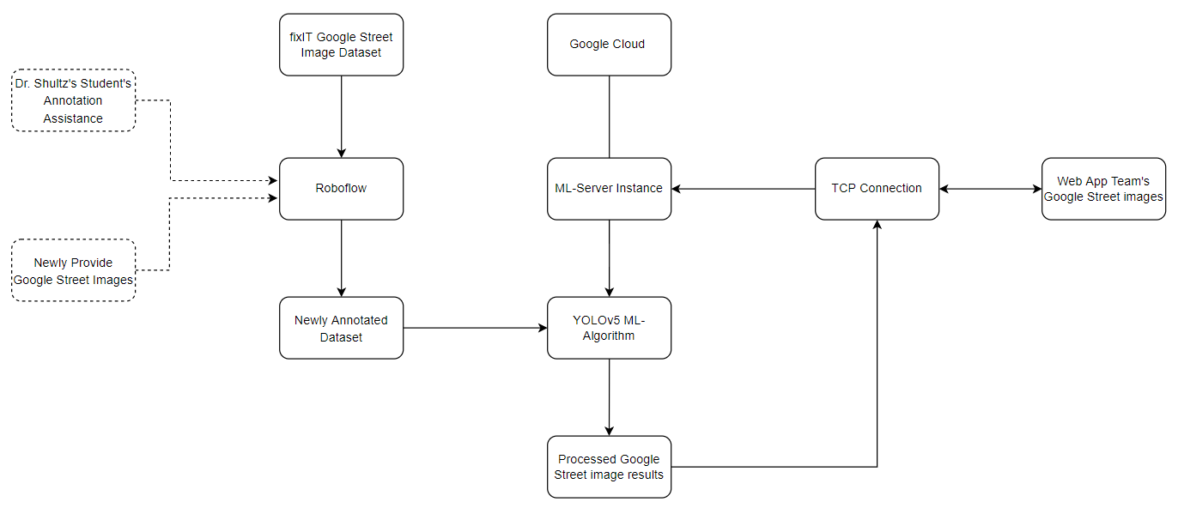
Closer View - Network Diagram
Notes:
Moving on we have a diagram of our system network.
As before, the core of our system is our Algorithm which is found in our server instance which is hosted on Google Cloud. One key difference from or previous version is that we changed from working with YOLOr to YOLOv5 as Keith will discuss later.
Our current version of the algorithm has been trained on a dataset that is a annotated version of the Fixit team’s dataset and we are currently working to develop this further with images that we received from the web app team and and annotation assistance provided by Dr. Schultz and his students. As such our current model does not implement litter categorization as Miguel will explain a little later
The standard way that our system operates has not changed since our first prototype. I will go through a quick review of how it works. First the user will connect to our instance via a TCP connection and send the images that they want the detection algorithm to run on. These images will be passed on to the Algorithm which will process the images, format the results, and send them back through the TCP connection to the user.
This concludes the overview of our network diagram. Now i-I’d like to pass it over to our project manager Juan who will cover our project management section.

Slide 5
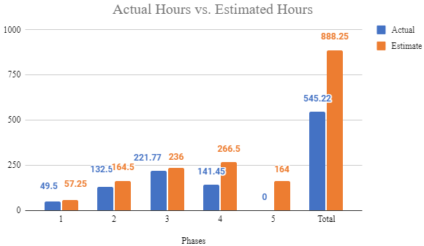
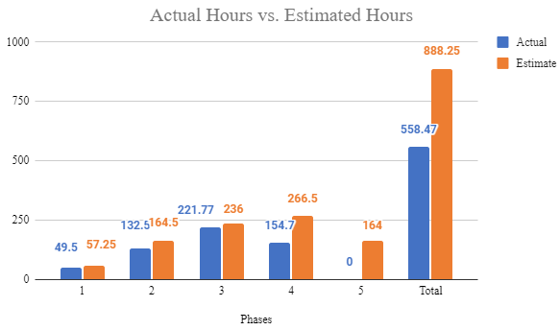
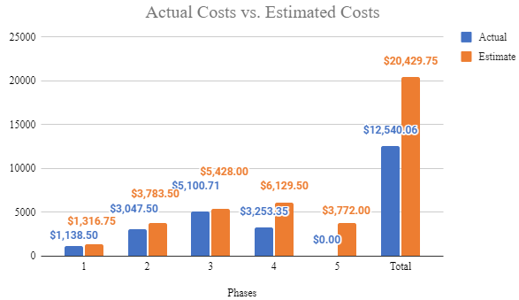

Project Management - Estimated vs Actuals
We will assume an hourly rate of $23.00 per hour for this project.
Notes:
Go over planned versus actual hours accumulated throughout this project, up to this point in Phase 3. (Take about 5 or more minutes, alongside the Prototype #1 tasks.)
Script:
Hello, I’m Juan the project manager/ Thank you Jordan
I’ll be going over the estimates vs actuals, for both Hours and Costs. Actual vs Estimated Hours for Phases 1-4 to this point. In phase 1 it’s shown we accumulated 49.5 actual hours (shown as the blue bar) vs 57.25 estimated hours (shown in orange). This is reflected on the cost chart, in which costs will be based on a $23 dollar hourly wage. where Phase 1 has an actual cost of $1,138.50.
In Phase 1, we initially worked on loading a single image with a Mask R-CNN model, which was assigned by Jared for us to do. However, we then focused more on getting a better grasp on important concepts of Machine Learning instead, with the same model, as well as identifying requirements and technical specifications for the project.
Phase 2 shows 132.5 Estimated hours and 164.5 actual hours, reflected by a $3,047.50 estimated cost and a $3,783.50 actual costs.
In Phase 2, our team started to look into new approaches for our machine learning algorithm development. This resulted in us switching to a two-phase model, where we first detect the litter in Google Street images, then, (this is conditional), categorize that litter into certain litter classes. This led us into looking into the YOLOR model, to fulfill the first phase of this two-phase approach, which will be better explained in future slides.
Phase 3 shows 236 Estimated hours and 221.77 actual hours, reflected by a $5,428.00 estimated cost and $5,100.71 actual costs.
In Phase 3, we began the construction of our system to receive, process, and detect litter in Google Street images from a user, for our Machine Learning project. Such progress so far has led us to creating the boneworks of our system through the utilization of a Google Cloud server, the integration of the YOLOR object detection model - with training and testing to detect litter in Google Street images, and the development of a Python script to formulate the process of our system - pertaining to inputs, outputs, and it’s ability to do frequent operations of processing Google Street images.
For Phase 4, this current Phase, the total number of estimated working hours spent towards development amounts to 266.5 hours, with a total cost of $6.129.50. However, we have accumulated just a total of 154.7 hours, with a total cost of $3,558.10, due to complications.

Slide 6
Project Management - Prototype #2 Tasks
Compile Annotation Documentation
For Roboflow’s annotation tool general usage in the future, and more importantly Dr. Schultz’s students usage.
Refinement - ML Training
Further training done with our previous dataset, re-annotated, with new training parameters. Just for detecting litter still.
Prototype 2 - ML Testing & Algorithm Processing
Examining the algorithms results, and adjusting the Python script and training parameters accordingly for the best litter detection.
Build pipeline to Web App Team
Connect with Web App team to allow them to use our ML algorithm.
Collate Litter Metrics
Collect/adjust our results from our ML algorithm to be accessible & acceptable for the Web App team.
(Conditional: Categorize Litter) Initial - ML Training
Training with a combined dataset, of old and new, due to complications.
(Conditional: Categorize Litter) ML Testing & Algorithm Processing
Mainly just reviewing & adjusting the new dataset, to better our algorithms processing & results.
Prototype #2 Tasks
108.45 out of 154.7 Actual Hours
Notes:
Go over main/most important tasks, like what they are and the hours spent, within Phase 3. Such as training, script development, etc. (Take about 5 or more minutes, alongside the Planned vs Actual hours.)
Script:
Next I will give a recap of the MAIN tasks within Prototype #2 that our group planned/executed.
First up, Compile Annotation Documentation: where we compiled this document to guide new users to use Roboflow’s annotation tool. From creating an account to directions on where to annotate and how to do them. The document has been sent over to Dr.Schultz, to aid his students with directions on how to do the annotations for our new dataset of Google Street images. To give us litter class annotations to train with later on.
Next is Refinement - ML Training: Further training done with our previous dataset, re-annotated, with new parameters. Just for detecting litter still.
Prototype 2 - ML Testing & Algorithm Processing: Examining the algorithms results, and adjusting the Python script and training parameters accordingly for the best litter detection. This will be something Keith will better explain later on.
Build pipeline to Web App Team: Connect with Web App team to allow them to use our ML algorithm. We met with the web app team to provide them with our TCP client code, as well as explaining the functionality of our ML algorithm, and clearing up any confusion regarding the code itself, so that they can use it to utilize our Ml algorithm.
Collate Litter Metrics: Aimed to collect/adjust our results from our ML algorithm to be accessible & acceptable for the Web App team. However, current results that came from the algorithm were acceptable by the Web App team, so adjustments were not necessary to our current litter metrics.
(Conditional: Categorize Litter) Initial - ML Training- Training with combined dataset due to complications. This is due to the fact that Dr.Schultz students were negatively affecting our new datasets progress, thus halting our training to specifically categorize litter only.
(Conditional: Categorize Litter) ML Testing & Algorithm Processing: Due to the complications, this task has been just us mainly reviewing & adjusting the new dataset, to better our algorithms processing & results.
These tasks contributed to 108.45 hours, out of our 154.7 actual hours within this 4th Phase. The rest of the hours come from our meetings amongst ourselves, and with our client.

Slide 7
List of Deliverables
Machine Learning code/algorithm that will be compatible and usable with the Web App team.
Algorithm components:
Input of multiples Google Street images
Litter detection (YOLOv5)
Bounding box & JSON output (total amount of litter)
Show accuracy/confidence level in litter prediction
A scheduling hook by which the Web App team can use this algorithm.
Github repository: https://github.com/SushiTeam2022/KAAB-ML
Python script, Instructional user manual and documentation for development, and a fully functional, modified YOLOv5 model.
Conditional feature:
Categorize the litter (e.g. Plastic, Paper, Organics,...).

Slide 8
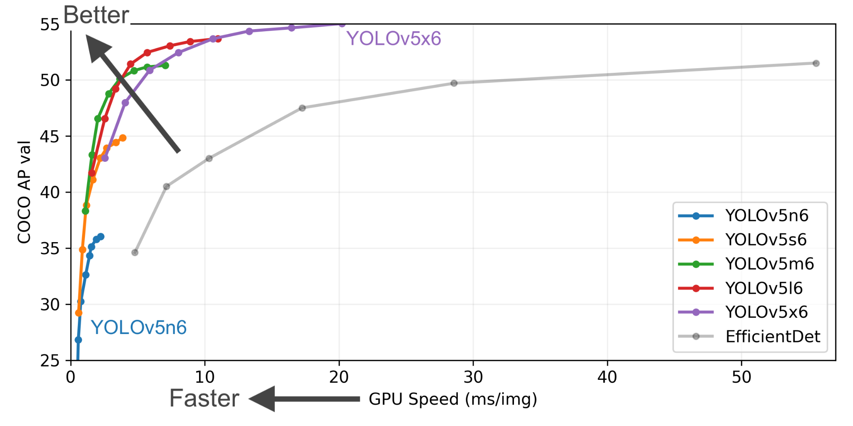
Analysis & Design
YOLOv5 - You Only Look Once
Design
Object Detection Algorithm
Divides Image into grid
Each Cell is responsible for detecting objects within itself
Processes
Cross Stage Partial Network - Backbone used to extract important features from image
PANet Feature Pyramid Network - Model Neck to extract features and output predictions
Model Head - Output of object locations, final predictions and scores, and generates bounding boxes
Benefits
Utilizes PyTorch machine learning framework
Faster object detection processing
Training optimization using SGD
Dataset
Utilizing previous semester’s collected Google Street Images
Pre-annotated litter objects
2592 images containing 9371 annotations
Notes:
Go over our particular object detection model, YOLOv5, and it’s capabilities/design/usage for our litter detection. As well as what one needs for it to work.
Also the datasets. (Take about 5 to 10 minutes, alongside the Continued Analysis & Design slide.)

Slide 9
YOLOv5 Requirements
Google Cloud Instance
N1-highmem-4 - Google Cloud Instance
4 vCPUs
26 GB memory
100 GB Balanced persistent disk - Storage for images and weights
NVIDIA Tesla T4 GPU - Cost Efficient GPU for machine learning
Google’s Deep Learning optimized Debian 10 image
Shared Access between group members
YOLOv5
PyTorch - Machine Learning Framework based on Torch library for Tensors
Torchvision - In model image transformations and augmentations
OpenCV - Image processing and computer vision library
Weights and Biases - Online real-time hyperparameter and training monitor

Slide 10
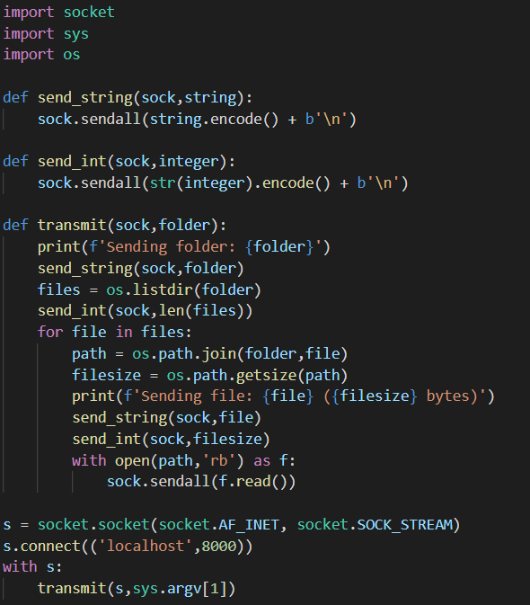
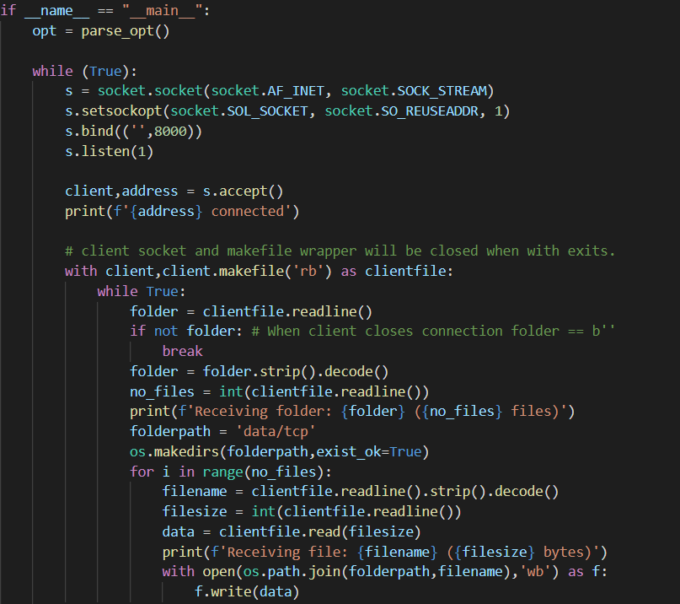
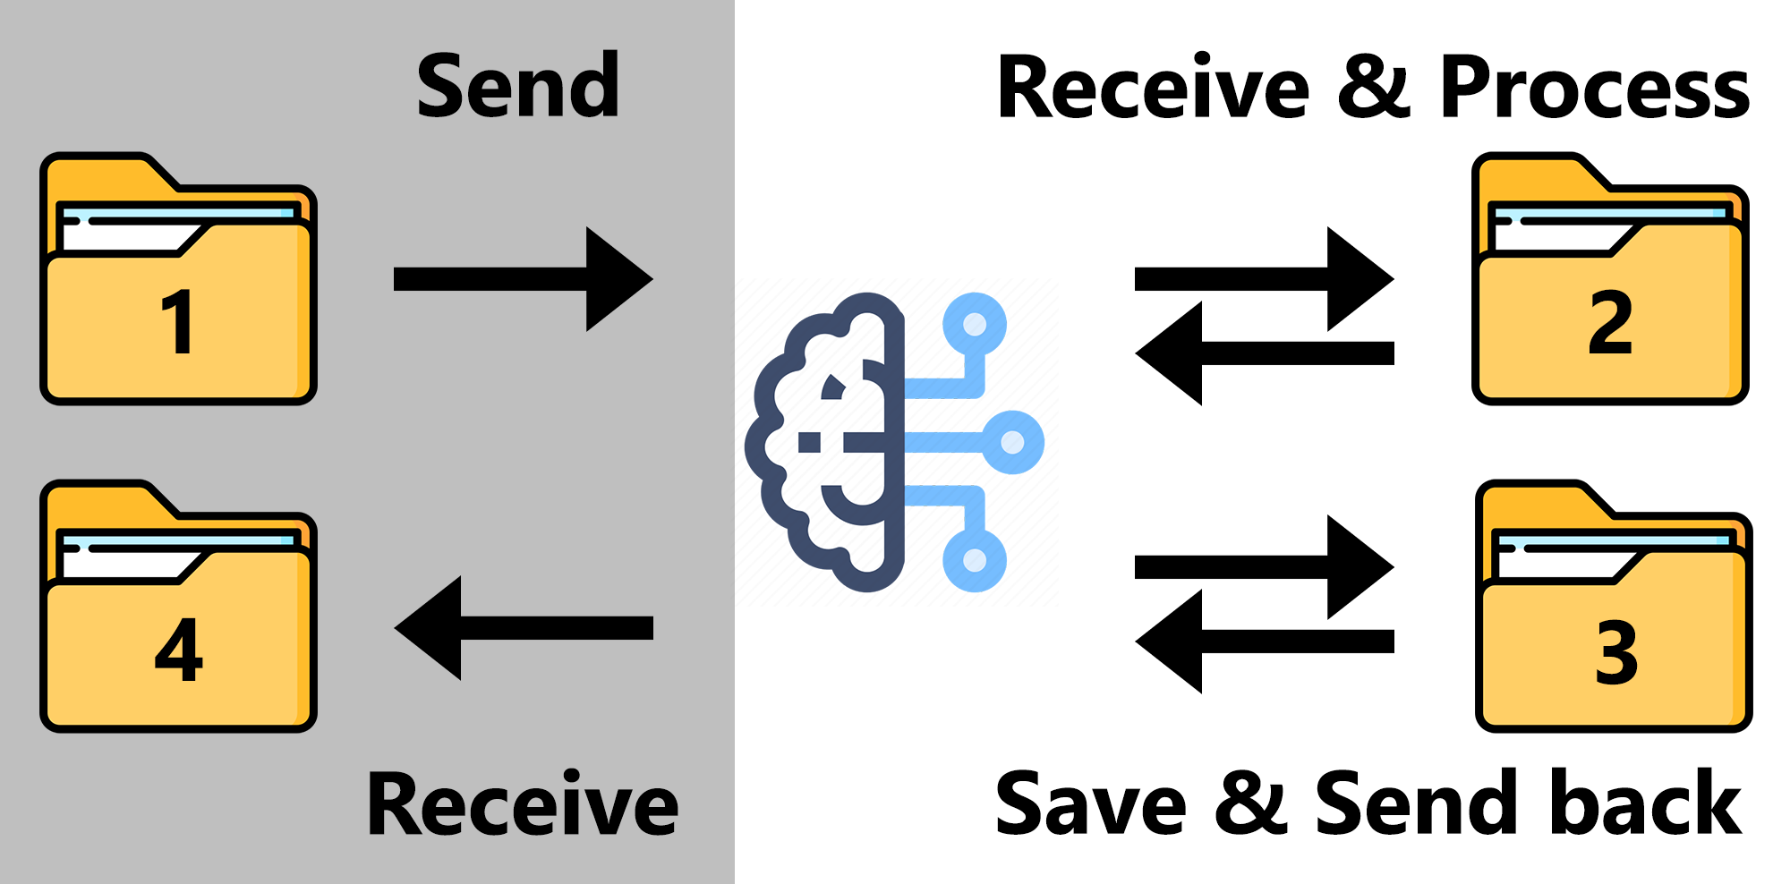
Prototype #2 Functionality - Client & Server
TCP connection: Sending a MULTIPLE images/contents of a folder.
Client side
Server side
$ python server_detect.py
$ python client.py client_images

Slide 11
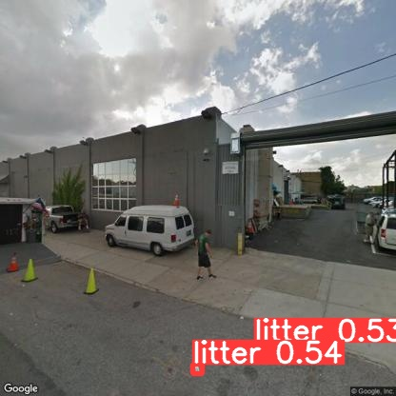
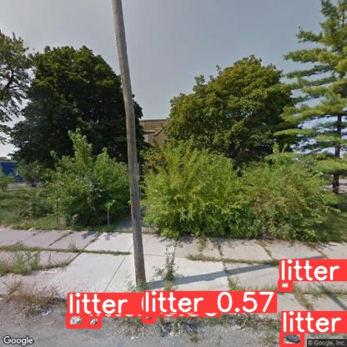

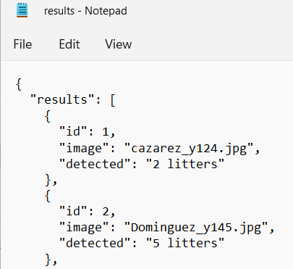
Prototype #2 Functionality - Results

Slide 12
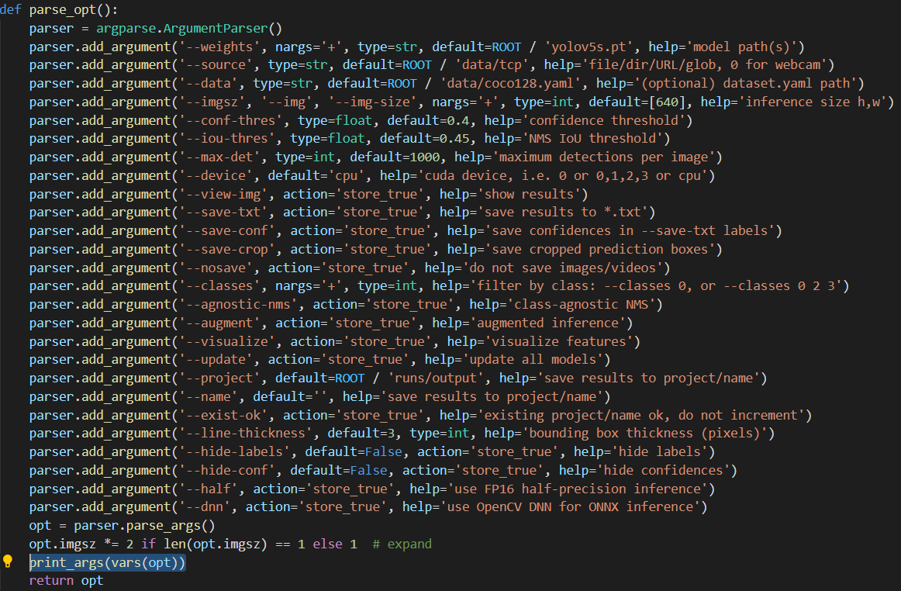
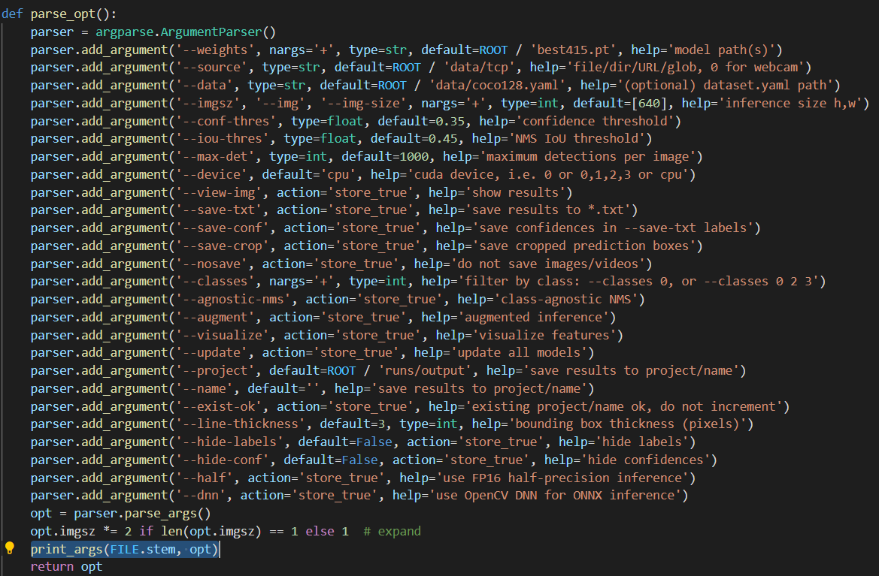
Prototype #2 Functionality - Minor Changes
NOW
BEFORE
YOLOv5 - April 15th, 2022 version
YOLOv5 - March 14th, 2022 version

Slide 13
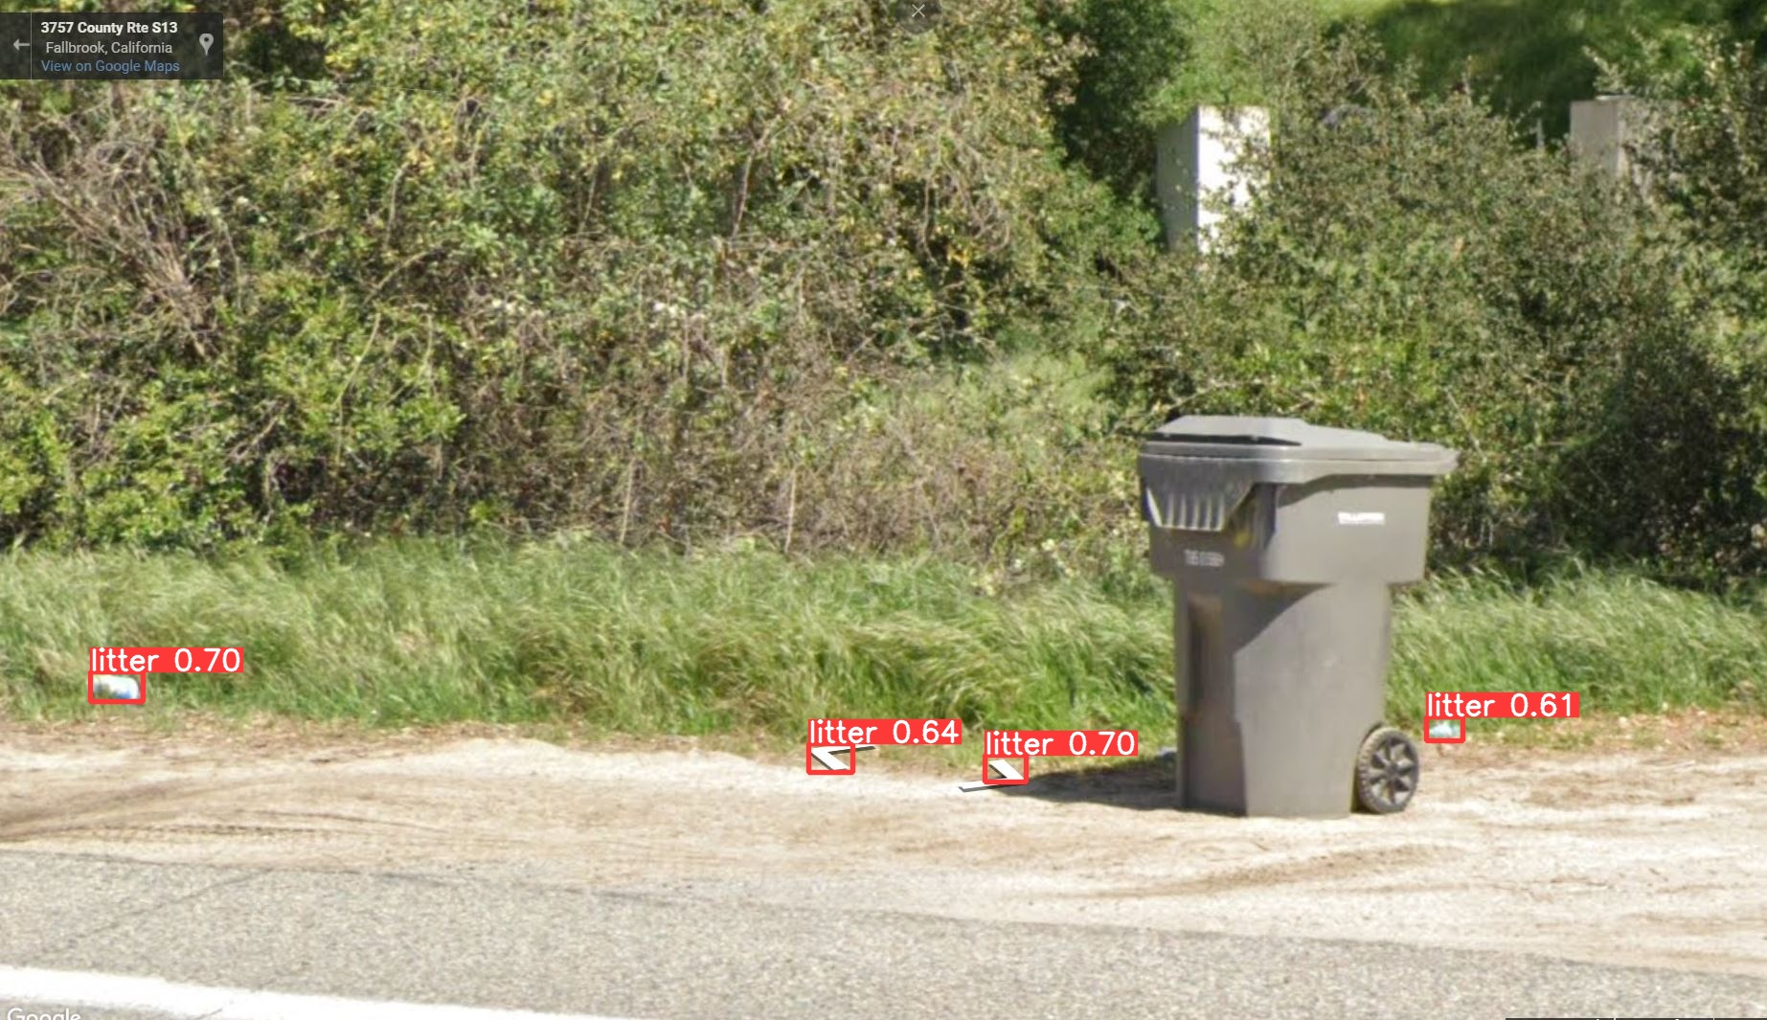
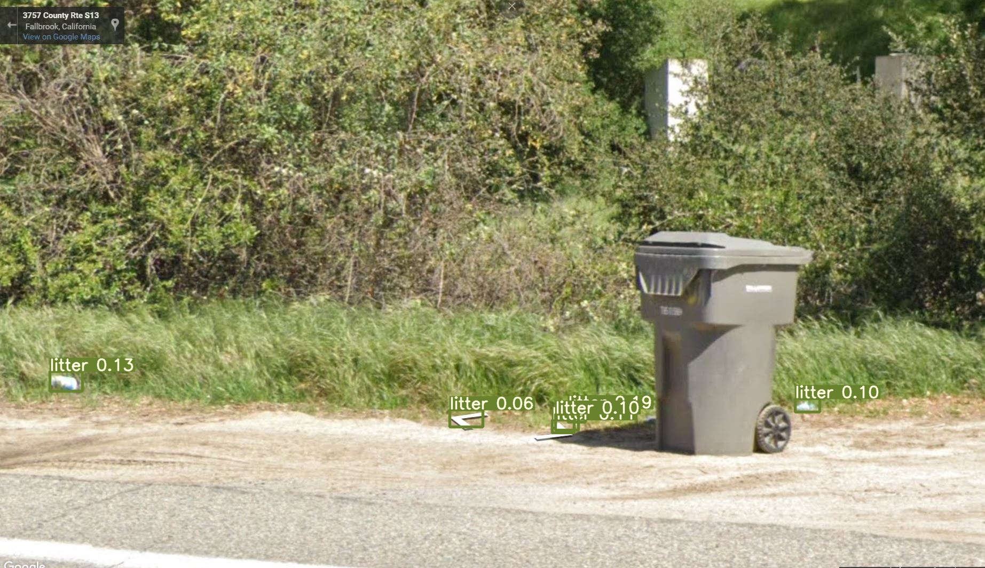
Prototype #2 Functionality - Minor Changes
NOW
Conf-thres = 0.35
Confidence level detection between 35% to 70%
BEFORE
Conf-thres = 0.05
Confidence level detection between 5% to 20%

Slide 14
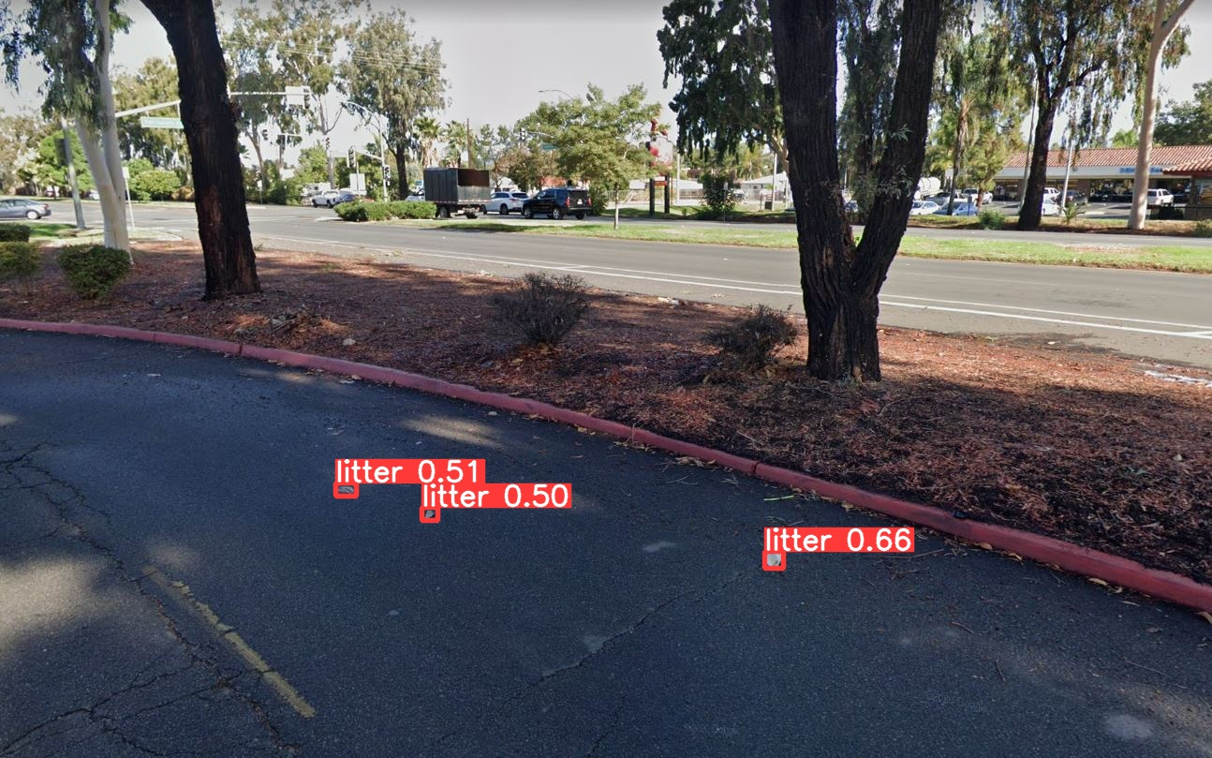
Prototype #2 Functionality - Minor Changes (That could be made)
(Low Res.) Street View Static API
Img-size = 640
(High Res.) Screenshot
Img-size = 1280

Slide 15
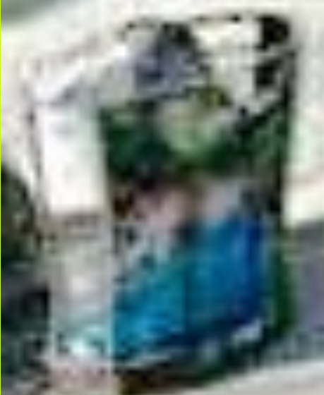
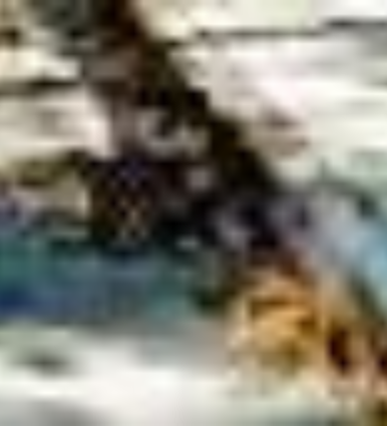
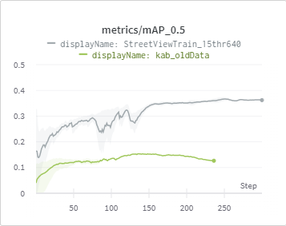
Analysis & Design - Issues
Dataset Disadvantages
Small Objects
Bounding Boxes not tight to object
Not all litter objects are annotated
Static Street Images are 640x640 px
YOLOv5 Disadvantages
Faster image processing results in lower precision
Initial Results
Maximum mAP@0.5 - 0.16
Low Precision and Recall
Notes:
Go over issues/limitations with the YOLOr model and datasets. (Take about 5 to 10 minutes, alongside the initial Analysis & Design slide.)

Slide 16
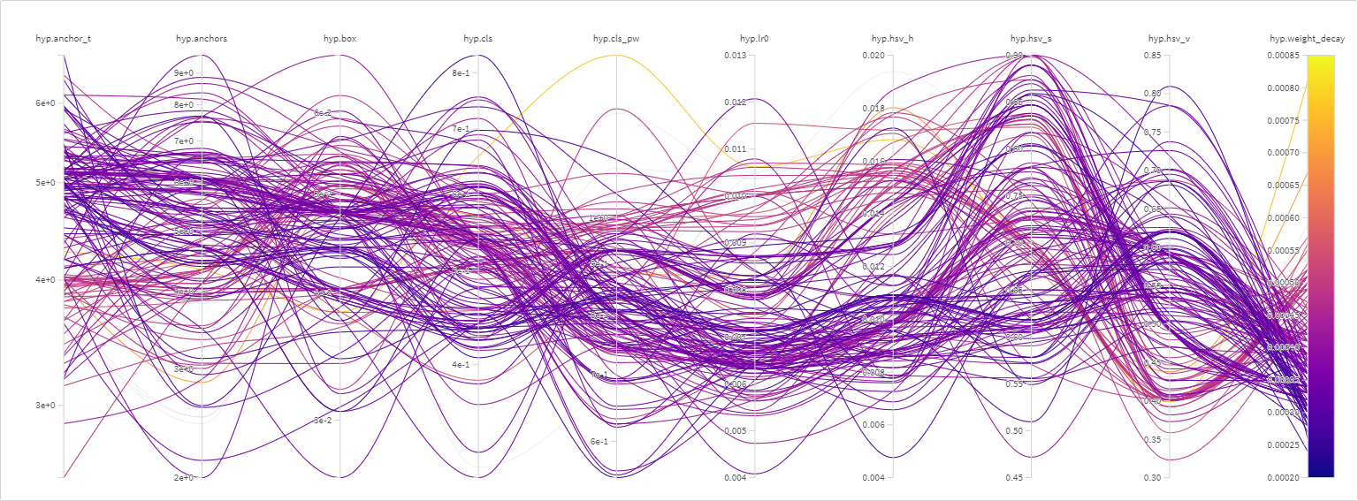
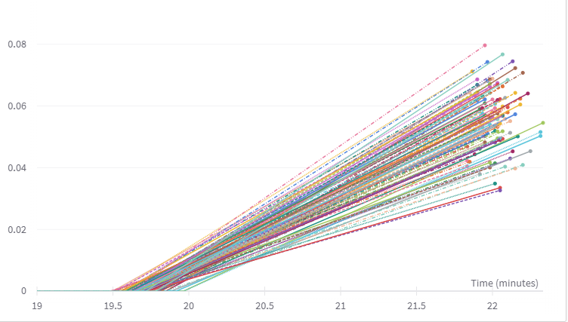
Solutions
Improved Street Image Collection Parameters
Tighter FOV
Downward Pitch
Re-annotation of existing dataset
Using Roboflow annotation functionality
Use Tiling Augmentation on Image
Splits image into 4 images
New image can be upsized resulting in more pixels per object.
Generates Null Images used for False Positive Reduction
YOLOv5 model
Hyperparameter Evolution Training
Varies 25 different training parameters over 300 generations and saves the best result
Tiny Bounding Box Rejection
Reject Boxes with sides less than 7 pixels or an area of less than 96 pixels
Test Time Augmentations
Augments image and bounding boxes to increase model resilience, effectively increasing dataset image count

Slide 17
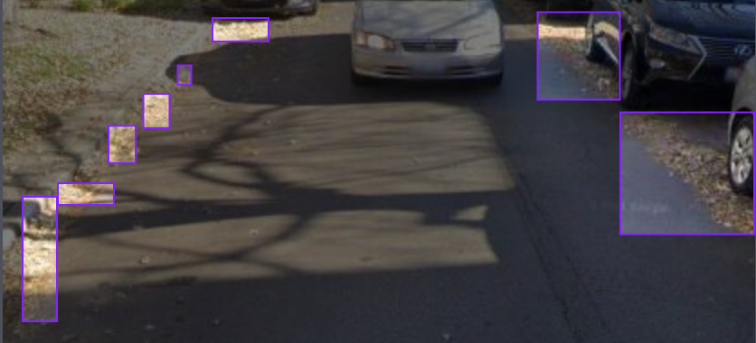
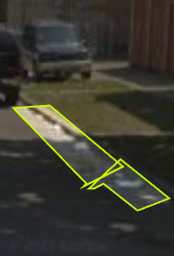
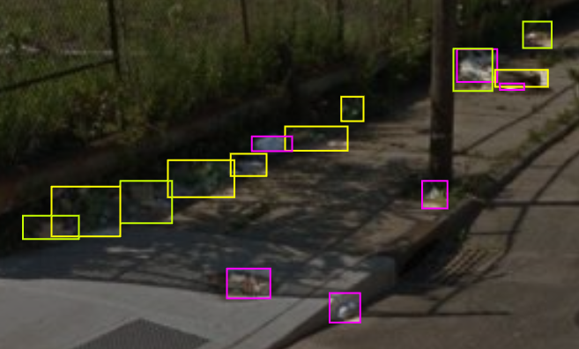
Final Thoughts and Goals
Progress:
Roboflow & Dr. Schultz’s students
Students were added to the project and were given specific instructions on how to annotate.
Students assigning themself “Jobs”.
Approving their own work & more.
Using the wrong tool for annotations.
Poor annotation quality.
Creating the new class “litter” among provided classes
Slowing down progress on litter categorization.
Forcing us to review & fix the annotations.
Merged, instead of New, Dataset for now
Litter classes of current, small new dataset have been collapsed to just litter.
Merged with old dataset to better litter detection.
Next objective:
Litter categorization, if we can.
If we can’t, then commit to improving just Litter detection.
……………………………………………………………………………………
..
Moving with yoloR model
Training is been conducted
Input/Output
Goal
Next phase
categorization
Notes:
Draw out thoughts about our current progress, how we’ll adapt to our current issues, and our further goals/decisions till the next Prototype session. (Take about 5 or more minutes.)
Go over on how we’ve tried to, and what we’re doing now, to adapt to our current issues.
(Such as finding different sources of images, trying to increase Google Street image resolution and add buffers to them - ask Keith about, as well as re-annotating the previous groups dataset.)
Be sure to go in detail, like how Roboflow has that annotation helper, and how it works.
Recap our current progress, as well as current direction with the Web App team (such as the 10,000 Google Street images), and Dr. Schultz’s students (who will annotate the new images on Roboflow - which we’ll be able to see/approve of.
(Again, ask Keith about stuff with Roboflow, and Jordan about stuff with the Web App team.)
Then question on how it all appeals towards Jared, as well as confirm and agree upon our direction for the next Phase, either towards refinement on what we have (with YOLOr), or to start adapting towards the categorizing of litter (through YOLO v5), or both.M

Slide 18
Feedback & Questions?
Notes:
Receive feedback, uncover further requirements, modify list of deliverables, and modify project scope. (Should take about 15 or so minutes.)

